Slide 1

OOSA&D(2018)
Baking with OO goodness: the Factory Pattern

Slide 2
Review:The Decorator Pattern
The Decorator Pattern attaches additional responsibilities to an object dynamically. Decorators provide a flexible alternative to subclassing for extending functionality.

Slide 3
Reviw: Design Principle
The Open-Closed Principle
Classes should be open for extension, but closed for modification.

Slide 4
Glossary
instantiate
concrete
store
defer
parameterize
Parameter
Dependency inversion principle
实例化
具体的
商店
使推迟
参数化
参数
依赖倒置原则

Slide 5

Agenda
A Case Analysis
Design Pattern: The Factory Pattern
In-class practice
An experiment in class
Practices of design pattern as homework
Dalian Neusoft University of Information © Copyright

Slide 6
Agenda
A Case Analysis
Design Pattern: The Factory Method Pattern
In-class practice
An experiment in class
Practices of design pattern as homework
Dalian Neusoft University of Information © Copyright

Slide 7
Code study: Calling the constructor
Duck duck;
if (picnic) {
duck = new MallardDuck();
} else if (hunting) {
duck = new DecoyDuck();
} else if (inBathTub) {
duck = new RubberDuck();
}
This type of code will often lead to problems when new types have to be added.

Slide 8
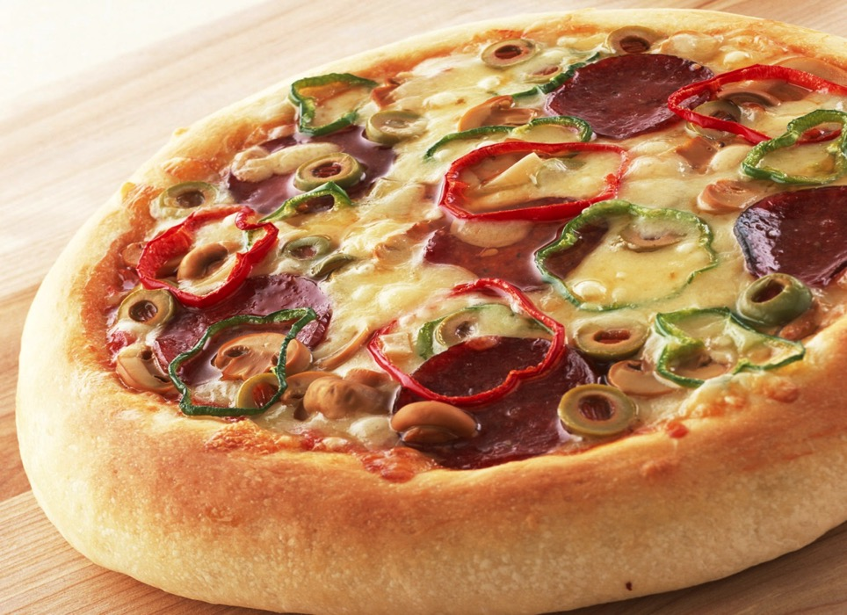
Example: A pizza store…

Slide 9

Our job is:
To design a pizza Store, which could create different types of pizzas.

Slide 10
Another example in similar vein
Pizza orderPizza(String type){
if (type.equals(“cheese”)) {
pizza = new CheesePizza();
} else if type.equals(“greek”)) {
pizza = new GreekPizza();
} else if type.equals(“pepperoni”)) {
pizza = new PepperoniPizza();
}
pizza.prepare();
pizza.bake();
pizza.cut();
pizza.box()
}

Slide 11
Identifying the aspects that vary
If the pizza shop decides to change the types of pizza it offers, the orderPizza method has to be changed.

Slide 12
Another example in similar vein
Pizza orderPizza(String type){
if (type.equals(“cheese”)) {
pizza = new CheesePizza();
} else if type.equals(“greek”)) {
pizza = new GreekPizza();
} else if type.equals(“pepperoni”)) {
pizza = new PepperoniPizza();
}
pizza.prepare();
pizza.bake();
pizza.cut();
pizza.box()
}
Part that varies.
Part that remains constant

Slide 13
Encapsulating object creation
if (type.equals(“cheese”)) {
pizza = new CheesePizza();
} else if type.equals(“greek”)) {
pizza = new GreekPizza();
} else if type.equals(“pepperoni”)) {
pizza = new PepperoniPizza();
}
SimplePizzaFactory

Slide 14
Building a simple pizza factory
public class SimplePizzaFactory {
public Pizza createPizza(String type) {
Pizza pizza = null;
if (type.equals("cheese")) {
pizza = new CheesePizza();
} else if (type.equals("pepperoni")) {
pizza = new PepperoniPizza();
} else if (type.equals("clam")) {
pizza = new ClamPizza();
} else if (type.equals("veggie")) {
pizza = new VeggiePizza();
}
return pizza;
}
}

Slide 15
Reworking the PizzaStore Class
public class PizzaStore {
SimplePizzaFactory factory;
public PizzaStore(SimplePizzaFactory factory) {
this.factory = factory;
}
public Pizza orderPizza(String type) {
Pizza pizza;
pizza = factory.createPizza(type);
pizza.prepare();
pizza.bake();
pizza.cut();
pizza.box();
return pizza;
}
}

Slide 16
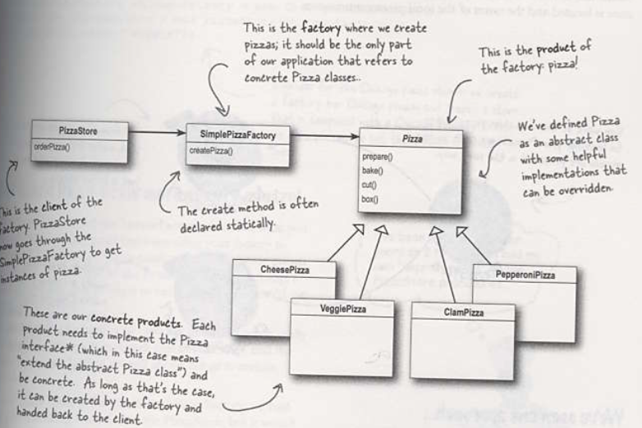
Simple Factory Defined

Slide 17
Complete example for Simple Factory
SimplePizzaFactory factory = new SimplePizzaFactory();
PizzaStore store = new PizzaStore(factory);
Pizza pizza = store.orderPizza("cheese");
Look at Eclipse

Slide 18
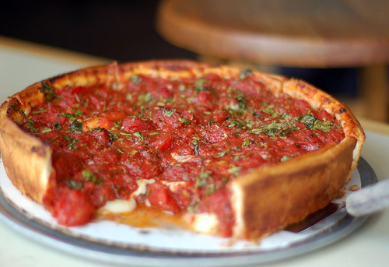
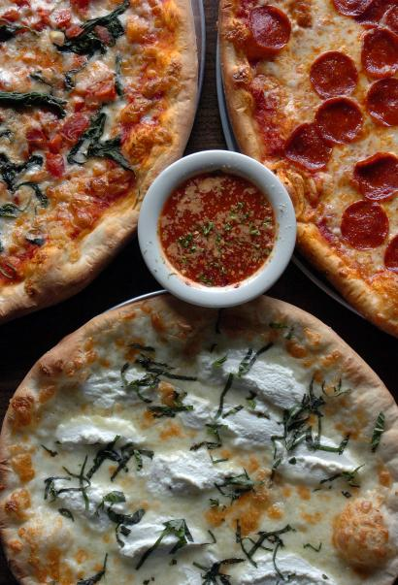
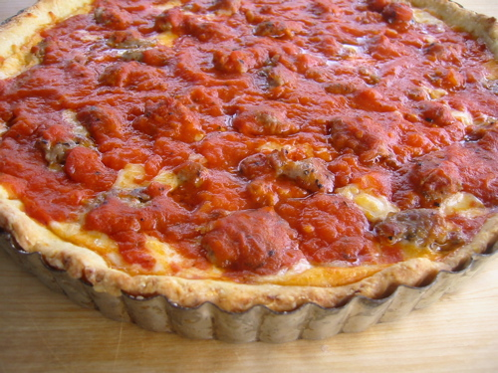
Franchising the pizza store
New York style
Chicago style

Slide 19
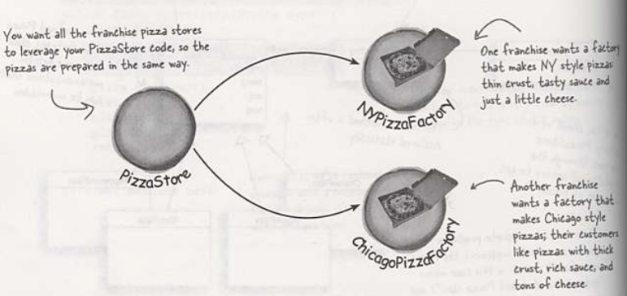
Franchising the pizza store

Slide 20
Creating multiple instances
NYPizzaFactory nyFactory = new NYPizzaFactory();
PizzaStore nyStore = new PizzaStore(nyFactory);
Pizza pizza = nyStore.orderPizza("cheese");
ChicagoPizzaFactory chicagoFactory = new ChicagoPizzaFactory();
PizzaStore chicagoStore = new PizzaStore(chicagoFactory);
Pizza pizza = chicagoStore.orderPizza("cheese");

Slide 21
Abstract method – a framework for the pizza store
public abstract class PizzaStore {
abstract Pizza createPizza(String item);
public Pizza orderPizza(String type) {
Pizza pizza = createPizza(type);
pizza.prepare();
pizza.bake();
pizza.cut();
pizza.box();
return pizza;
}
}

Slide 22
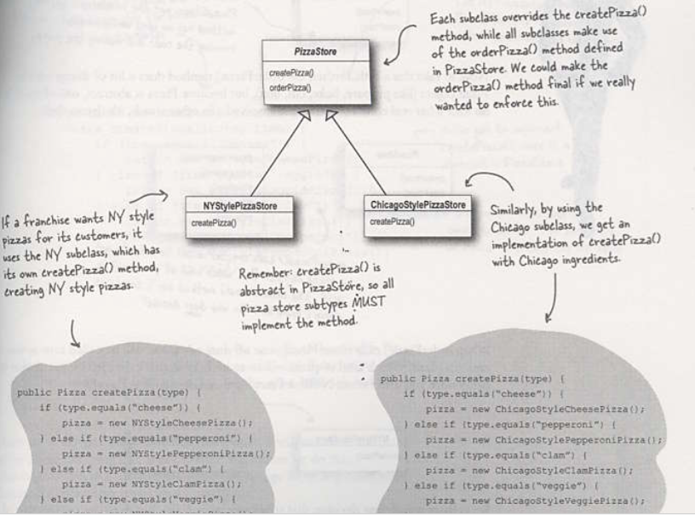
A framework for the pizza store

Slide 23
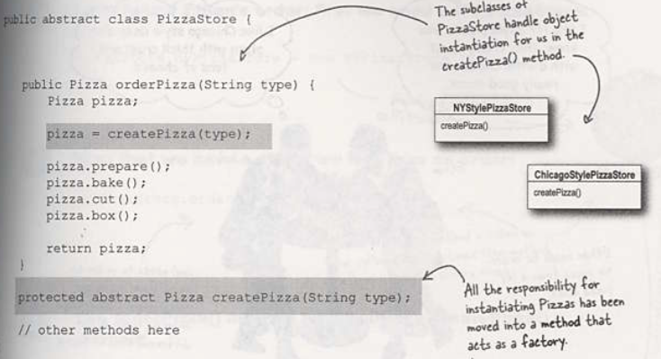
Declaring a factory method

Slide 24
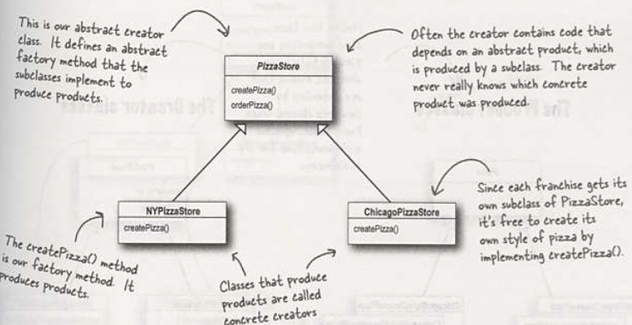
Allowing the subclasses to decide
A factory method handles object creation and encapsulates it in the subclass. This decouples the client code in the super class from the object creation that happens in the subclass.

Slide 25
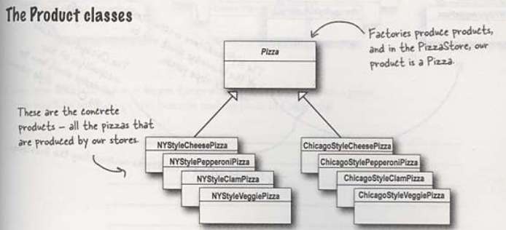
Factory Method Pattern

Slide 26
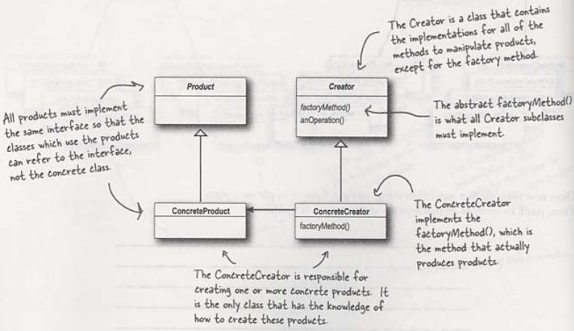
Class diagram: Factory Method

Slide 27
Agenda
A Case Analysis
Design Pattern: The Factory Method Pattern
In-class practice
An experiment in class
Practices of design pattern as homework
Dalian Neusoft University of Information © Copyright

Slide 28
The Factory Method Pattern
The Factory Method Pattern defines an interface for creating an object, but lets subclasses decide which class to instantiate. Factory Method lets a class defer instantiation to subclasses.

Slide 29
The Factory Method Pattern
Intent
Define an interface for creating an object, but let subclasses decide which class to instantiate. Factory Method lets a class defer(延迟） instantiation to subclasses.
Defining a “virtual”（虚拟） constructor.
The new operator considered harmful.

Slide 30
The Factory Method Pattern
Problem
A framework needs to standardize the architectural model for a range of applications, but allow for individual applications to define their own domain objects and provide for their instantiation.
一种为了标准化系列应用的体系结构模型而建立的框架，允许个体的应用定义自己的领域对象并提供实例化接口。

Slide 31
The Dependency Inversion Principle
Depend upon abstractions. Do not depend upon concrete classes.

Slide 32
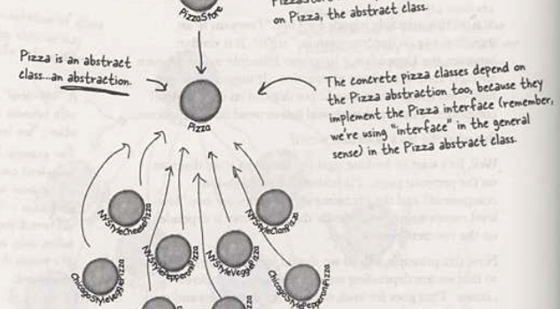
The Dependency Inversion Principle

Slide 33
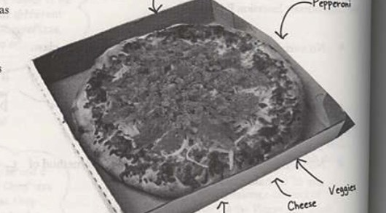
How to ensure the consistancy in the ingredients?

Slide 34
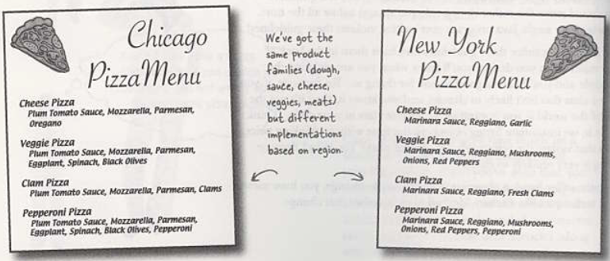
How to ensure the consistency in the ingredients?

Slide 35
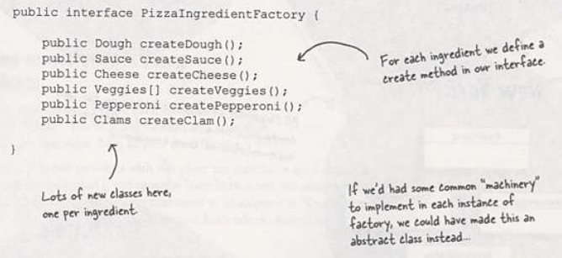
Building the ingredient factories

Slide 36
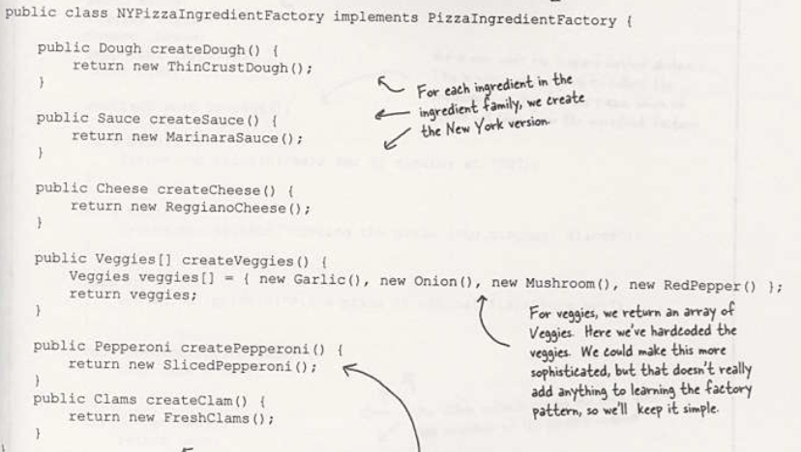
Building the New York ingredient factory

Slide 37
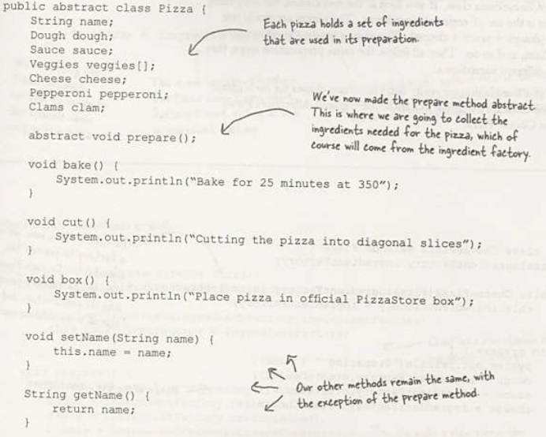
Reworking the pizzas

Slide 38
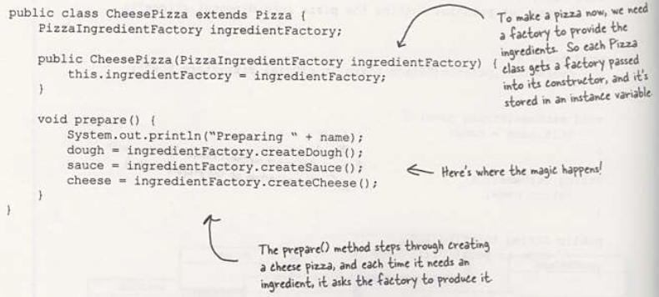
Reworking the pizzas

Slide 39
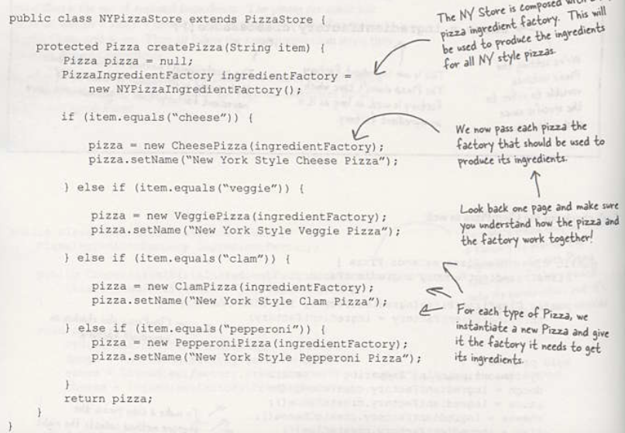
Revisiting our pizza stores

Slide 40
Abstract Factory pattern
The Abstract Factory Pattern provides an interface for creating families of related or dependent objects without specifying their concrete classes.

Slide 41
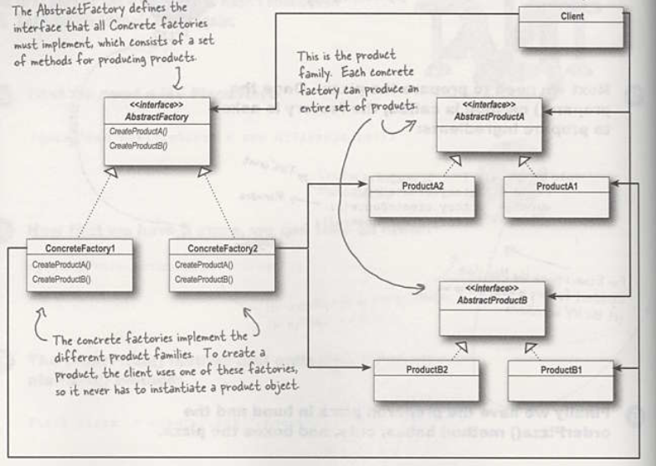
Abstract Factory pattern

Slide 42
Summary so far..(P162)
OO Basics
Abstraction
Encapsulation
Inheritance
Polymorphism
OO Principles
Encapsulate what varies
Favor composition over inheritance
Program to interfaces not to implementations
Strive for loosely coupled designs between objects that interact
Classes should be open for extension but closed for modification.
Depend on abstraction. Do not depend on concrete classes.

Slide 43
Checkpoints
What is factory pattern?
What is dependency inversion principle?
What is the purpose of factory pattern?

Slide 44
In-class practice
The original factory is divided into sub-factories for each brand of television, the Haier factory is responsible for the production of Haier TVs, the Hisense factory is specially responsible for the production of Hisense TVs, if there is a need for the production of TCL TV or Skyworth TV, we only need to add a new TCL factory or Skyworth factory, the original factories do not have to make any changes, which enable the whole system has more flexibility and scalability.
Your job is to…
Design the class diagram
program according to your class diagram
Test your design.
Dalian Neusoft University of Information © Copyright

Slide 45
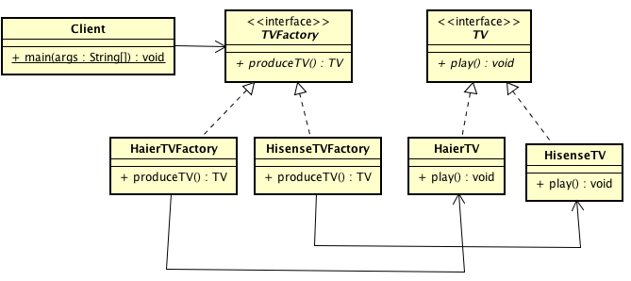
3. An Application for example
A monitoring system
Class Diagram

Slide 46
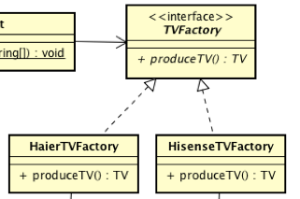
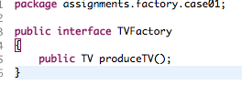
3. An Application for example
A monitoring system
Class Diagram

Slide 47
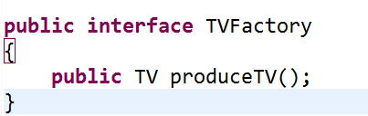
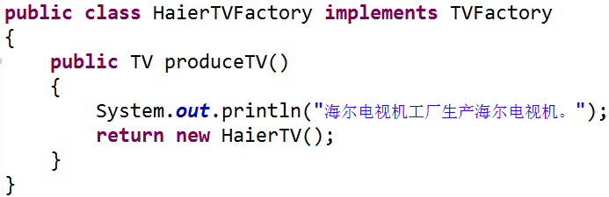
3. An Application for example
A monitoring system
Class Diagram

Slide 48
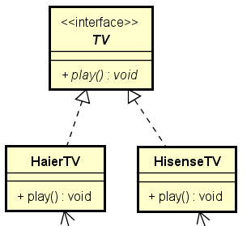
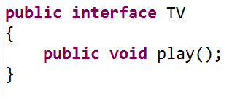
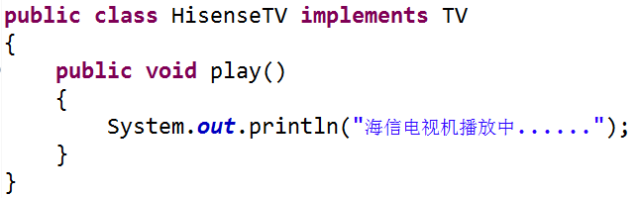
3. An Application for example
A monitoring system
Class Diagram

Slide 49
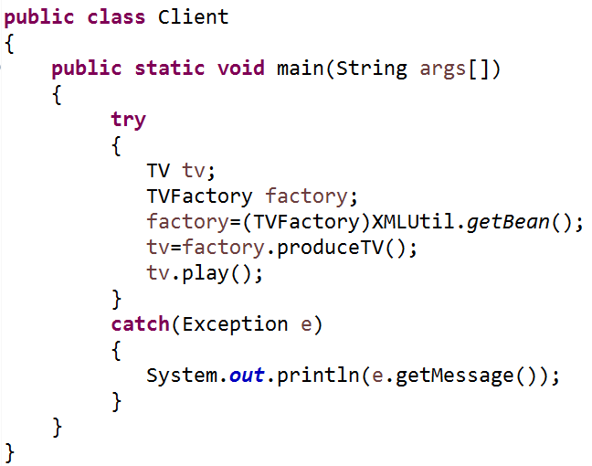
3. An Application for example
A monitoring system
Class Diagram

Slide 50
4.An experiment
In an OA system, the system is authenticated by comparing the account number and password entered by the user at logining time, the account number is stored in the database, and the user permission level ( stored as integer ) stored in the database too. Different levels of user are created according to different levels of authority and different levels of user have different operating permissions. Now please use factory method pattern to design the permission management module.
Your job is to…
Design the class diagram
program according to your class diagram
Test your design.
Dalian Neusoft University of Information © Copyright

Slide 51
5. Homework
Finish the homework, which includes 3 tasks.
Dalian Neusoft University of Information © Copyright

